Slide 1


    Understanding anxiety and depression
    Week two on the path to connection
©2021 NATHANSWAYPOINT, LLC | NATHANSWAYPOINT.COM

Slide 2
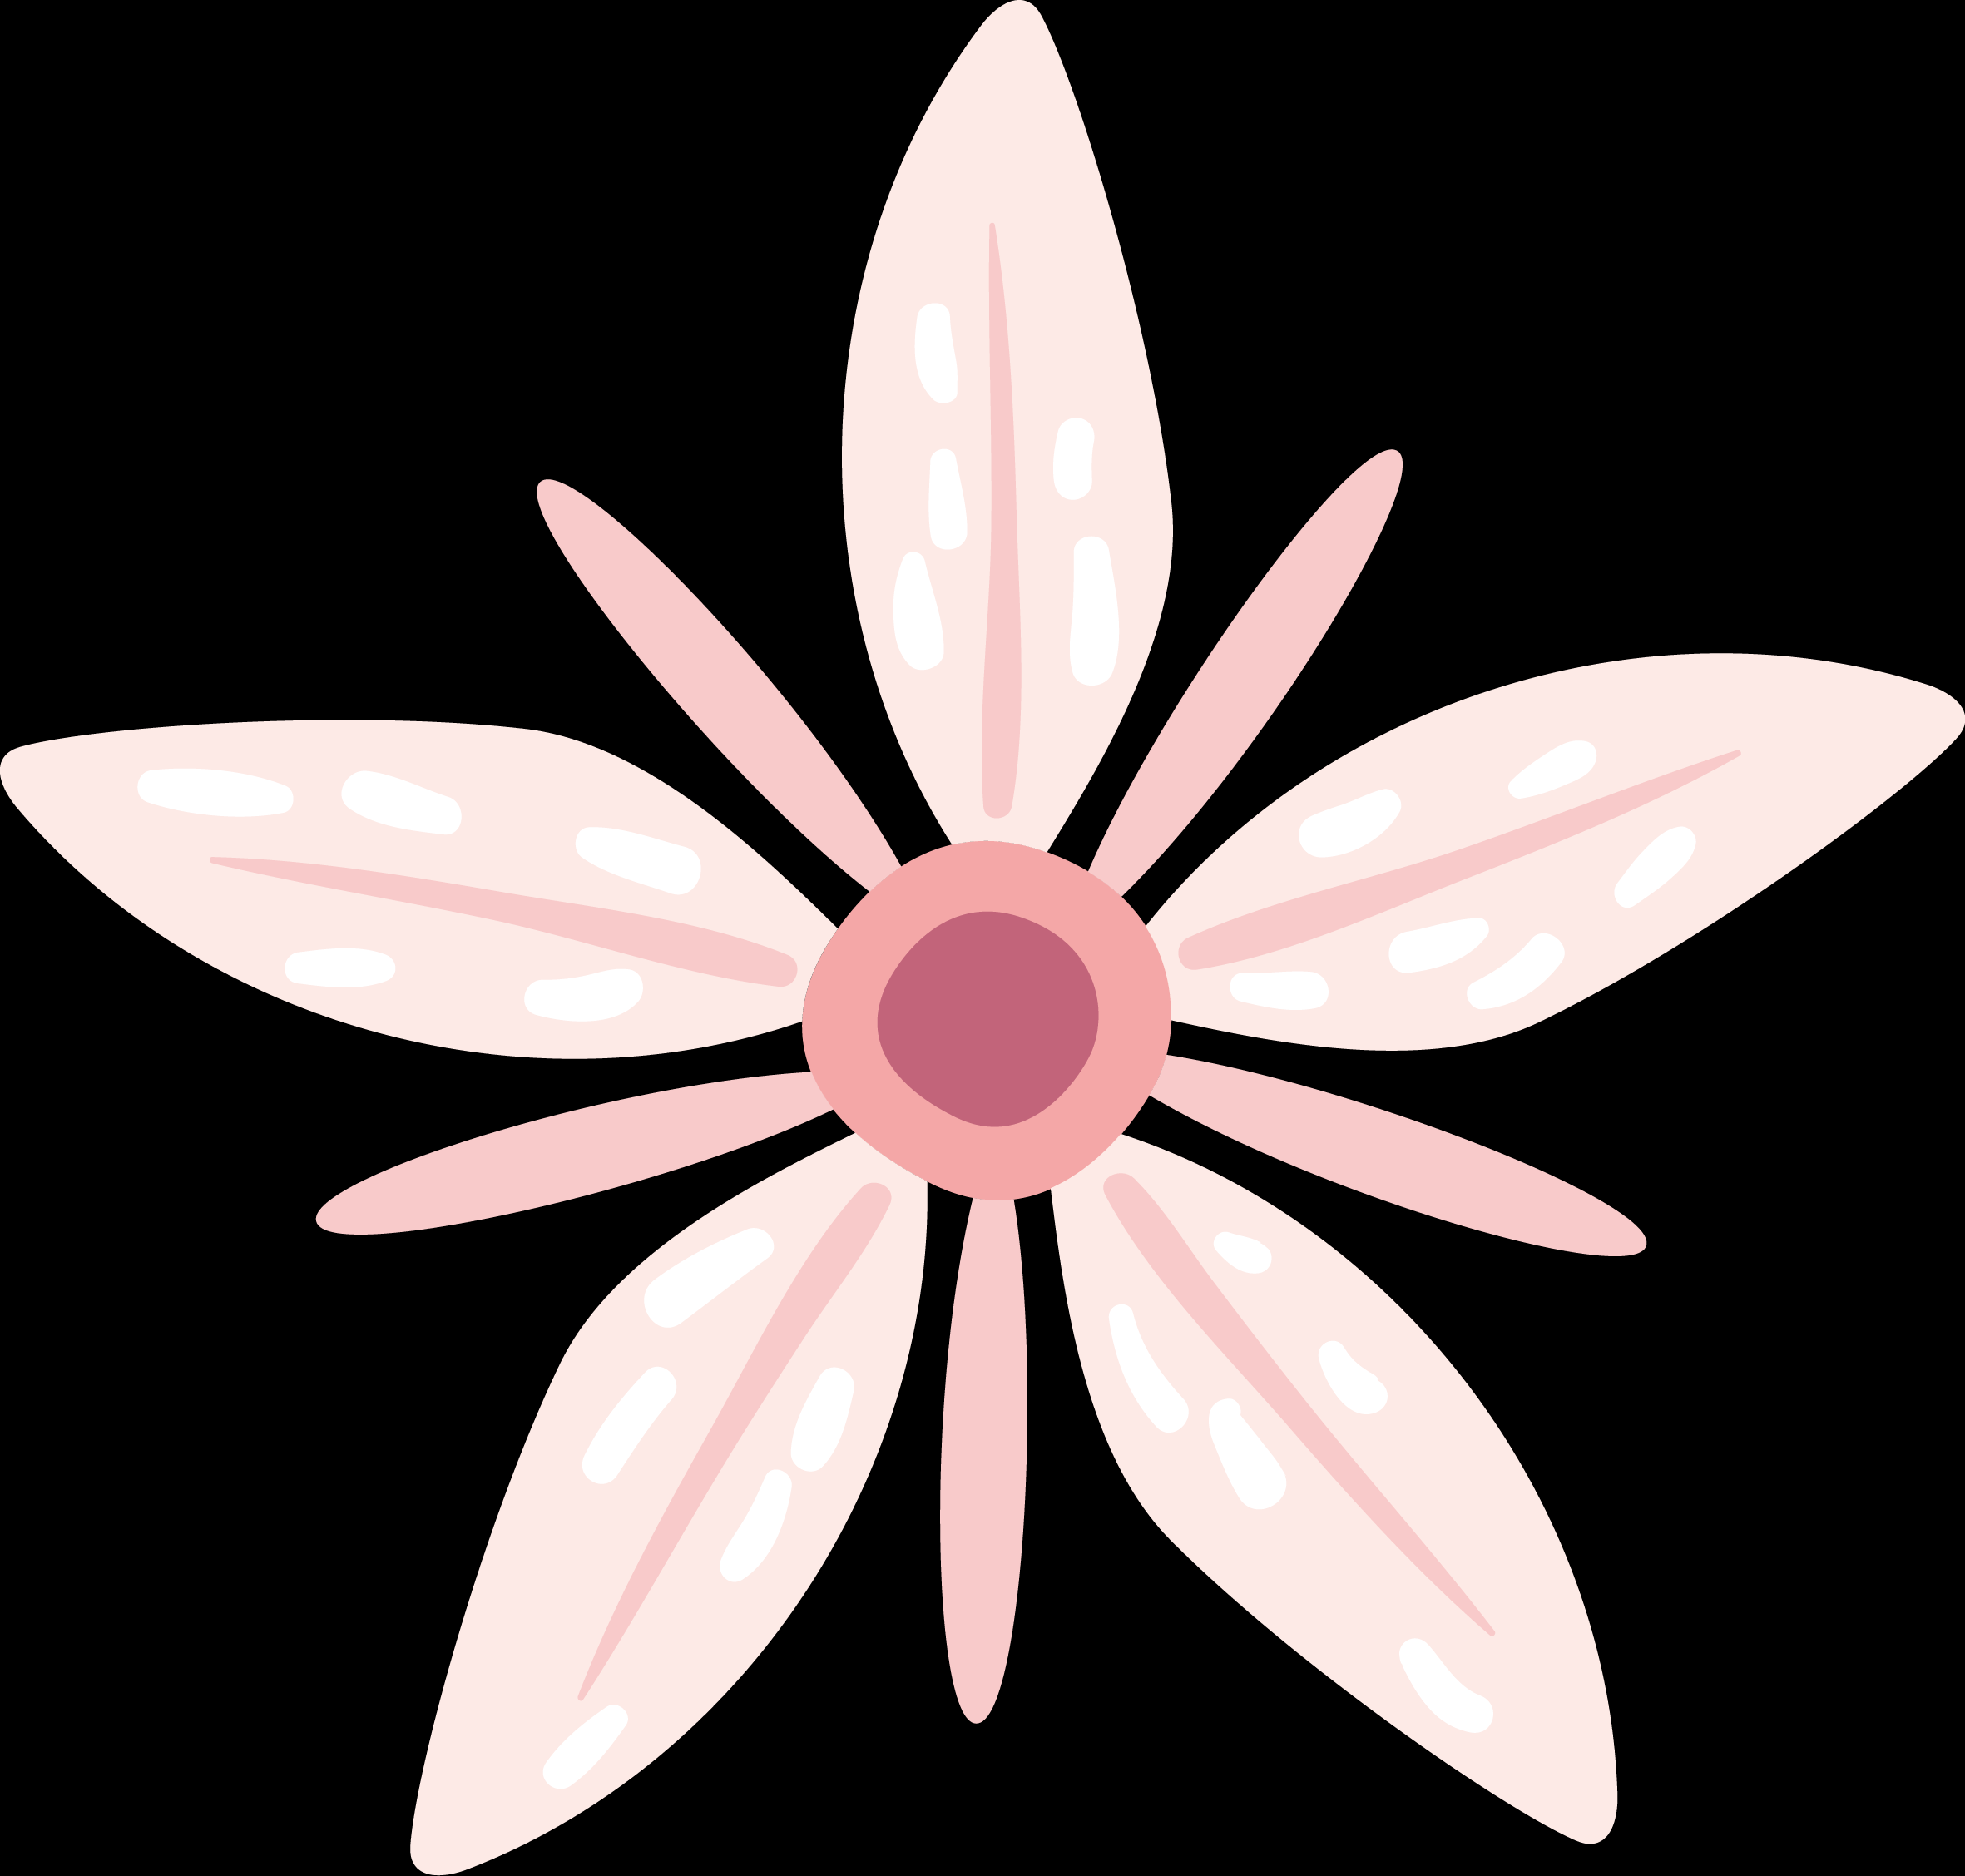
What you see v. what your child is experiencing
Overview
Brain development and anxiety and depression
What your child can and cannot control
        During this second week on the Path to Connection, we’ll focus on broadening your understanding of anxiety and depression. Often, if parents haven’t experienced anxiety and depression themselves, it’s hard to understand where your child is coming from and find ways to support them. Anxiety and depression are not rational and viewing them through a rational lense will usually leads to disconnect and conflict.
What you can and cannot control

Slide 3

What
others see

Slide 4
Healthy Anxiety
Unhealthy Anxiety
Focused on a single situation
Motivates
Helps us get thing done
Helps us try new things
Builds resilience
Broader in scope and scale
Intense
Seems greater than the situation calls for
Prevents action/participation

Slide 5
How Does Anxiety Show Up?
Organized
Outgoing
Overachiever
Helpful/Selfless
Focused
Perfectionist
Sleep Patterns
Eating Habits
Isolation
Screens
Physical Symptoms
Indecision

Slide 6
Some final thoughts . . .

Slide 7

Brain development and anxiety and depression
        Until the last decade, there was little research on the adolescent brain. It was believed that the adolescent brain was the same as the adult brain, just with less mileage on it.
        Researchers have learned that the teen brain is about 80% mature. The remaining 20% accounts for the behaviors that frustrate and frighten parents – mood swings, irritability, impulsiveness, lack of focus/follow through, risky decision.

Slide 8

Adolescence is defined as the period between childhood and adulthood.
In the 19th century, the first signs of puberty were at 17. Today the average start of puberty is age 12.
Newborns have 100B neurons. 17% are linked at birth. The rest get wired over our lifetime.
Wiring is driven by genetics and experience.
Some important information about adolescence

Slide 9
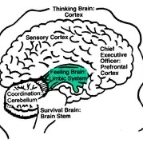
A QUICK OVERVIEW OF THE BRAIN
        Brain stem – instinct and unconscious physiological functions.
        Limbic system – seat of emotion – contains the hypothalamus, amygdala, thalamus and hippocampus.
        Sensory Cortex – conscious thought and reasoning. 80% of brain mass.

Slide 10

        The job of the prefrontal cortex is to think ahead to consequences and control impulses
        It is a major construction site during adolescence.
        Can’t distinguish between a GOOD decision and a BAD one, no matter how intelligent the child is.
        Quickness to anger results from poor impulse control.
Impulsivity and risk taking

Slide 11

        While the prefrontal cortex is under construction, the limbic system carries the weight in communication.
        Adolescents misread facial expressions as they filter through the amygdala rather than the PFC.
        The amygdala also drives the response to perceived anger, resulting in what you perceive as an overreaction.
        “Brakes” are also still under construction.
communication

Slide 12

Emotional regulation
        Hormone production ramps up at the beginning of adolescence.
        Increase in testosterone production for boys leads to overstimulation of the amygdala.
        Increase in estrogen and progesterone for girls can lead to mood swings, and influence reactions to stress, sex drive and appetite.

Slide 13


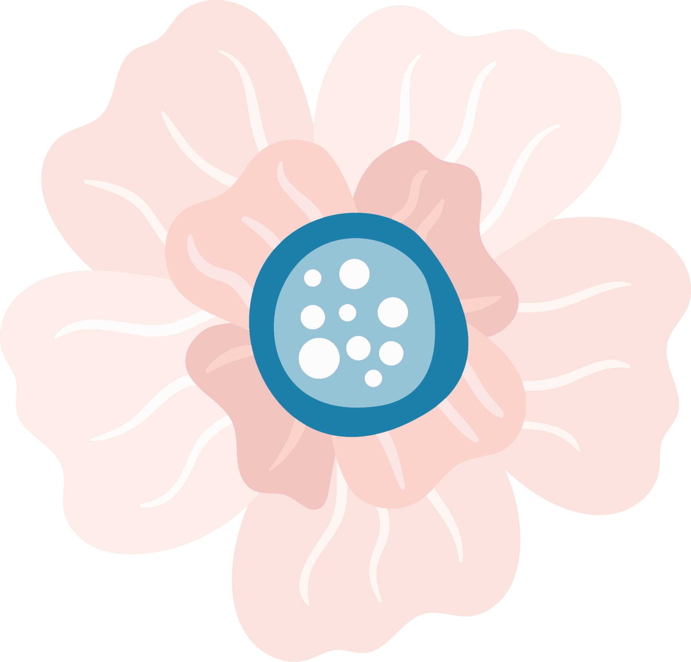
Gender differences
        Girls reach puberty earlier than boys.
        Left hemisphere develops before right in girls.
        Right hemisphere develops before left in boys.

Slide 14
A Summary on
Brain Development
    When should you be worried?

Slide 15

The fact that I can’t explain the feelings causing my anxiety, doesn’t make them less valid.
    Lauren Elizabeth

Slide 16
WHAT YOUR CHILD
CAN AND CANNOT CONTROL

Slide 17

WHAT IS OUTSIDE
YOUR ANXIOUS/DEPRESSED
TEEN’S CONTROL?
        The emotions associated with anxiety and depression;
        The very real fear that is a main symptom of anxiety;
        The physical symptoms that can result from anxiety and depression;
        The fatigue, overwhelm and lack of motivation that accompany anxiety and depression.

Slide 18

WHAT CAN YOUR TEEN CONTROL?
        Willingness to participate in opportunities to learn coping mechanisms anxiety/depression;
        Choice to try new, healthier coping mechanisms and accept support doing it;
        Recognition when they’re hurt another with their anxiety response and willingness to address it;
        Efforts to take small steps to help them feel better.

Slide 19
WHAT YOU CAN AND CANNOT CONTROL

Slide 20
Our anxiety does not come from thinking about the future, but from wanting to control it.
    Kahlil Gibran

Slide 21

WHAT IS OUTSIDE YOUR CONTROL?
        Whether your child engages in their school, extra-curricular or social life;
        Whether your child participates in therapy or other treatment options;
        How your child feels;
        What your child eats.

Slide 22

WHAT CAN
YOU CONTROL?
        Validating your child’s reactions and emotions;
        Modeling communication and managing difficult emotions;
        Establishing and enforcing boundaries;
        Engaging in your own self care.

Slide 23

Closing
thoughts
        Anxiety and depression can show up differently every single day. That’s one of the things that makes it so hard for you to know how best to support your child. Gaining a clearer understanding of how anxiety and depression show up, what might be typical behaviors for a teenager (and maybe not anxiety and depression) and what you and your child can and cannot control will help. Learning to step back and consider what’s happening based on your new knowledge is an important step on the Path to Connection with your teen.

